Slide 1
Module 1: Python for Starters - Class01
Welcome to Python

Slide 2


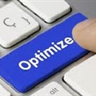
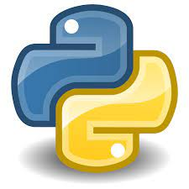

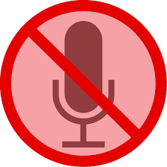


KSH Session Practicalities
Welcome to a new MELA NMSD SL Optimize Knowledge sharing session! Python Upskill for NDO Workshop
Practicalities
  1h session
  Post your questions on the chat. Questions will be answered at the fly or at the end.
  Attendance has been muted.
  Cameras have been disabled
  Session is being recorded
  Find in the Python Upskill for NDO Workshop Degreed Plan the Pathways with the recorded sessions, ppts and materials

Slide 3
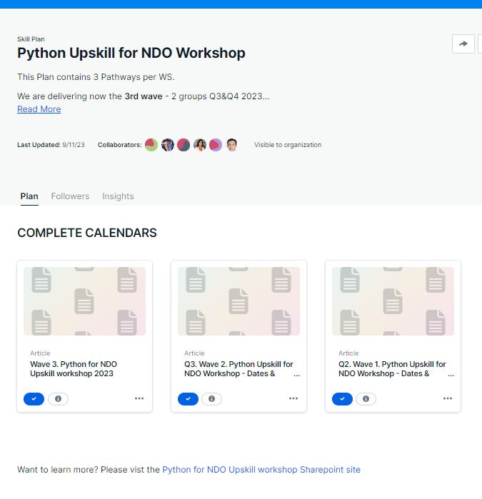
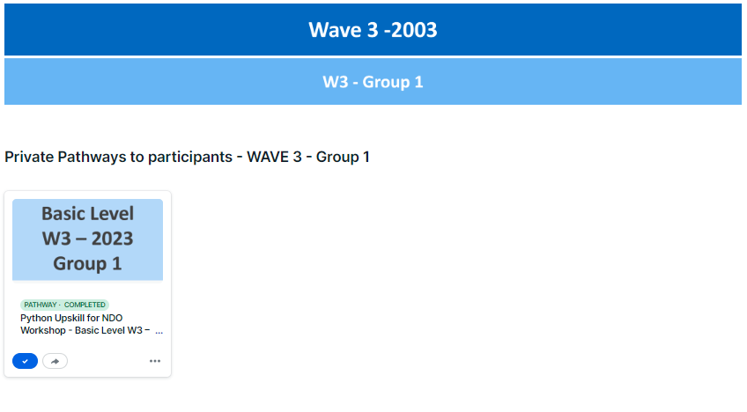
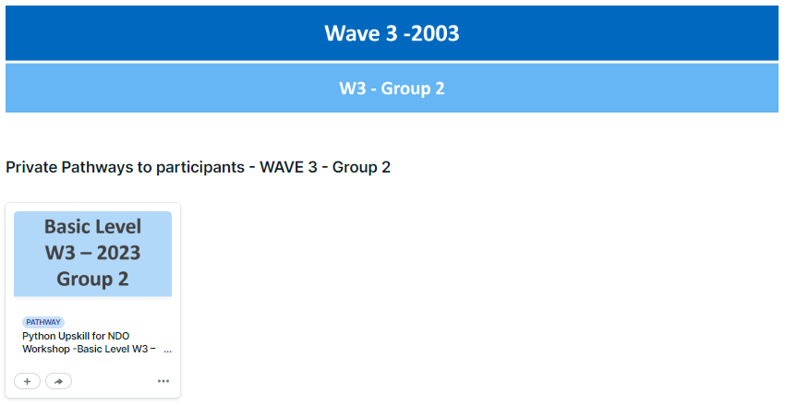
Python Upskill for NDO Workshop Degreed Plan
Pathways
per Level
WS Complete Calendar
SharePoint Site

Slide 4
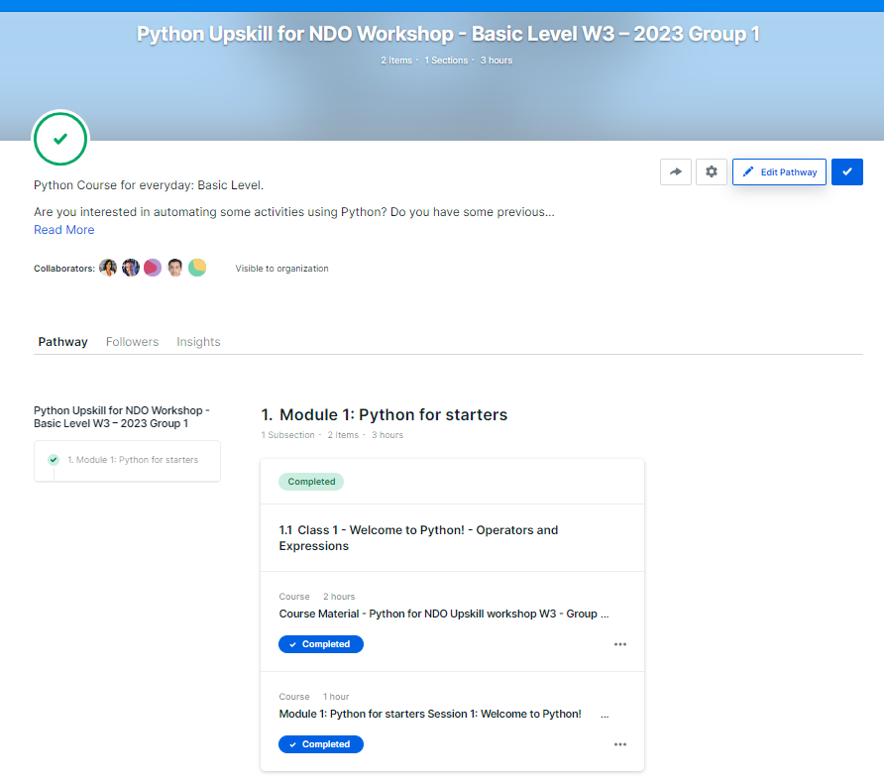
Python Upskill for NDO Workshop Degreed Plan
Pathway
Basic Level
Organized by Class
In the “material” you will access to the SharePoint where you can find the PPT & Files used during the session
In the “video” you will access to Ericsson Play where you can watch the recorded session
In case of issues, doubts or ideas to improve! please contact Ximena Galano

Slide 5

Brief Introduction: What is Python?
Python is a powerful and easy-to-learn programming language. has efficient, high-level data structures and a simple but effective approach to object-oriented programming (OOP).
Python's elegant syntax and dynamic typing, together with its interpreted nature, make it an ideal language for rapid application development and scripting in many areas and on most platforms.
This language was created by Guido Van Rossum in the early 90's, its name is inspired by the English comedy group "Monty Python".
Notes:
In the mid-1980s a dutch fellow named Guido van Rossum was working on an educational project to build a language for new coders called ABC

Slide 6
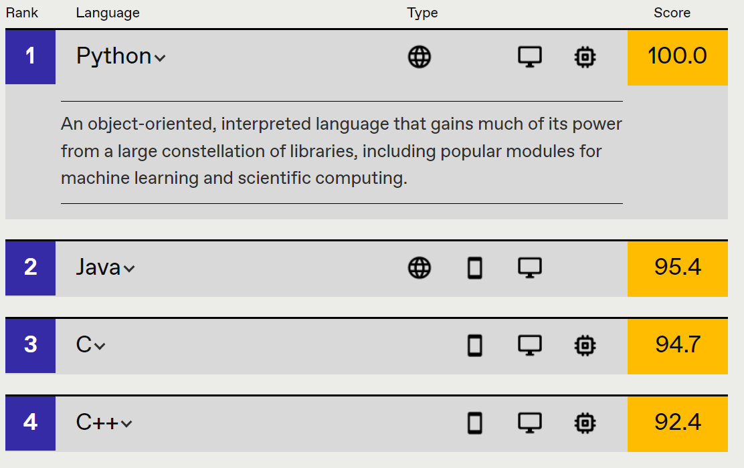
Brief Introduction: Why Python?
IEEE Spectrum defines it as a multi-paradigm, dynamic, multi-purpose programming language designed to be fast-to learn, use and understand-and to enforce a clean, uniform syntax.
It is one of the most versatile programming languages that exist, it can be used in many different fields. That is to say, it allows programming from video games to web applications.
https://spectrum.ieee.org/top-programming-languages/#toggle-gdpr
Notes:
Python is a backend programming language that’s great for beginners.
Python syntax is very similar to English, so it’s intuitive, which helps you understand what’s going on. You don't have to look up what symbols mean when you use Python.
Python is approachable. Even if you haven’t taken a Computer science class, you can still write a useful tool in Python.
Python can be used for automate task , gather information or perofrom step by step task in your browser, and manage information, in your excel files, log files, data bases, etc.
The Python community is welcoming, well-maintained, and well-documented. That’s important for a beginner!

Slide 7
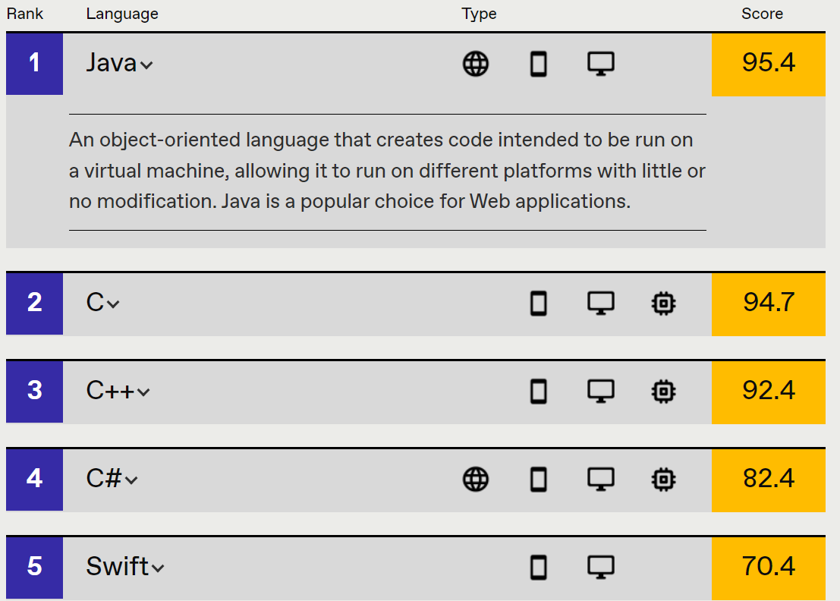
Brief Introduction: Why Python?
Python is living its golden age having a high ranking in web and enterprise development; however, python does not have much space in mobile development, in that case java is still the most used.

Slide 8
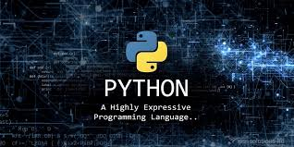
Brief Introduction: Python Features
These are the main features of python
Is an interpreted language
Has dynamic typing
Is strongly typed
Is cross-platform
Is multi-paradigm

Slide 9
Brief Introduction: Python Features
Compiled vs Interpreted
Compiled
A compiled language is converted into machine code so that the processor can execute it
The compiled programs run faster than interpreted programs.
Interpreted
An interpreted language is a language in which the implementations execute instructions directly without earlier compiling a program into machine language.
The interpreted programs run slower than the compiled program.

Slide 10


Brief Introduction: Python Features
Static Typing vs Dynamic Typing
Static typing: the typing check is performed during compilation, not during execution.
Dynamic typing: typing check is performed during execution instead of during compilation

Slide 11
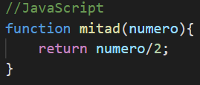
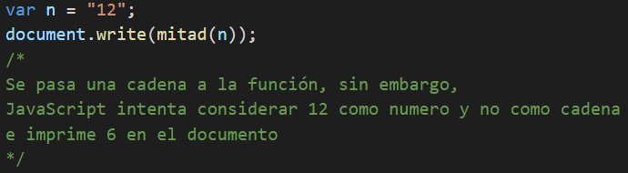
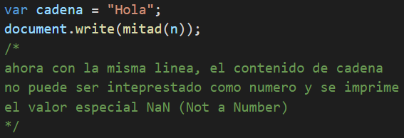
Brief Introduction: Python Features
Strong Typing vs Weak Typing
Weak Typed: when data type violations are allowed

Slide 12



Brief Introduction: Python Features
Strong Typing vs Weak Typing
Strong Typed: when data type violations are not allowed

Slide 13
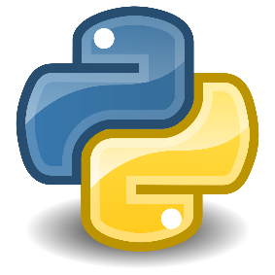
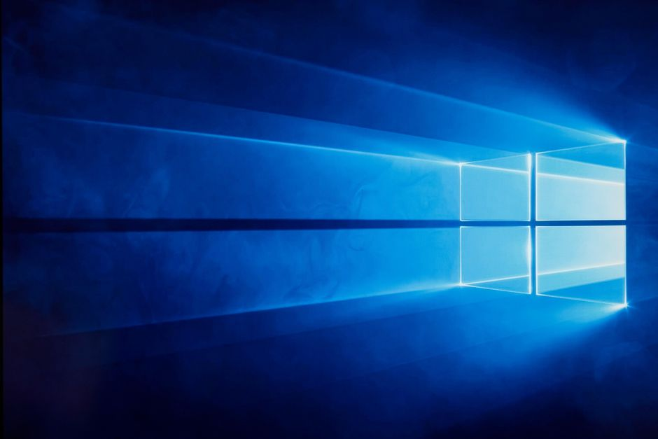
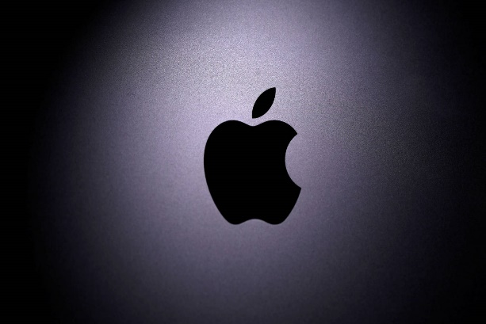
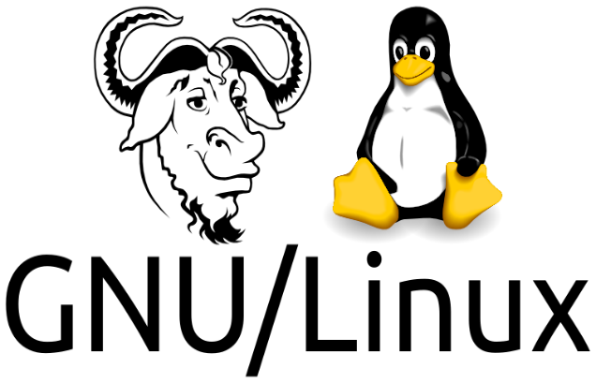
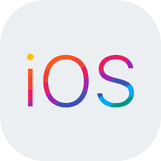
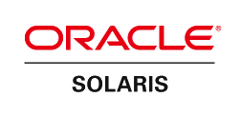
Brief Introduction: Python Features
Cross-Platform
Pythonista
AvtivePython

Slide 14
Brief Introduction: Python Features
Multi-paradigm
Object Oriented Programming (OOP) : Based on Classes and Objects
Structural Programming : Based on Functions
Imperative Programming: Traditional sequence-based programming.
Functional Programming: Based on Mathematical Functions

Slide 15
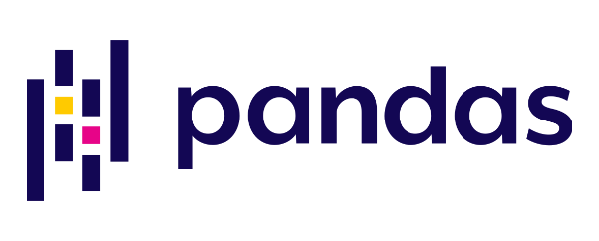
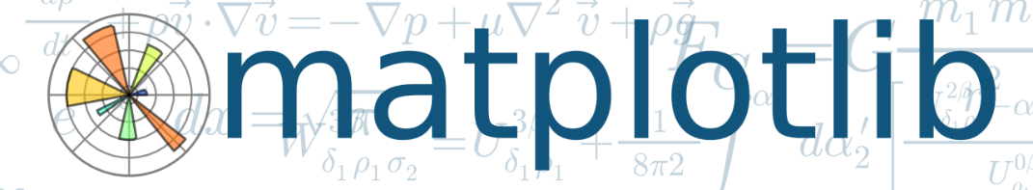
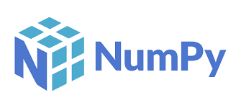
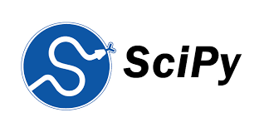
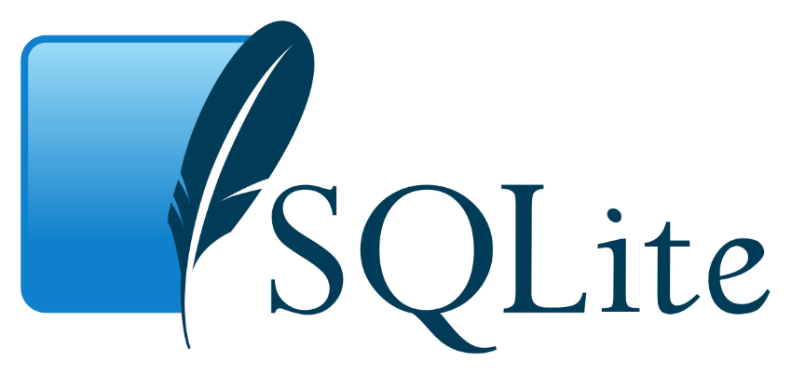
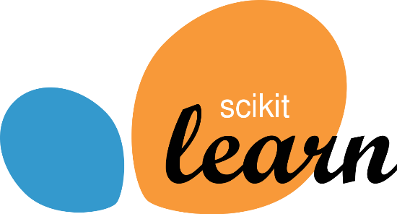
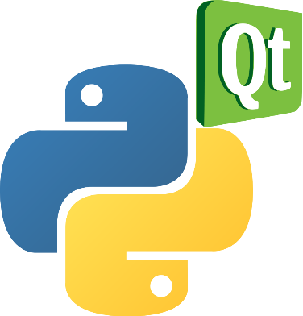

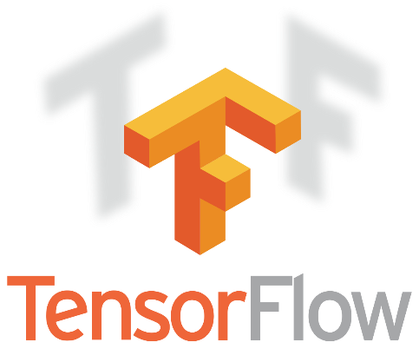
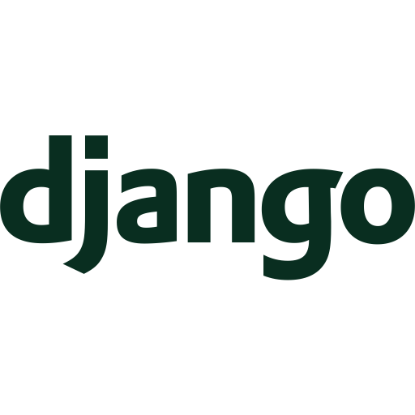
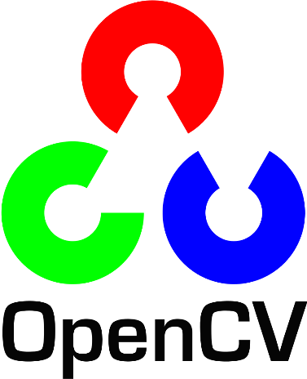

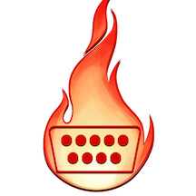
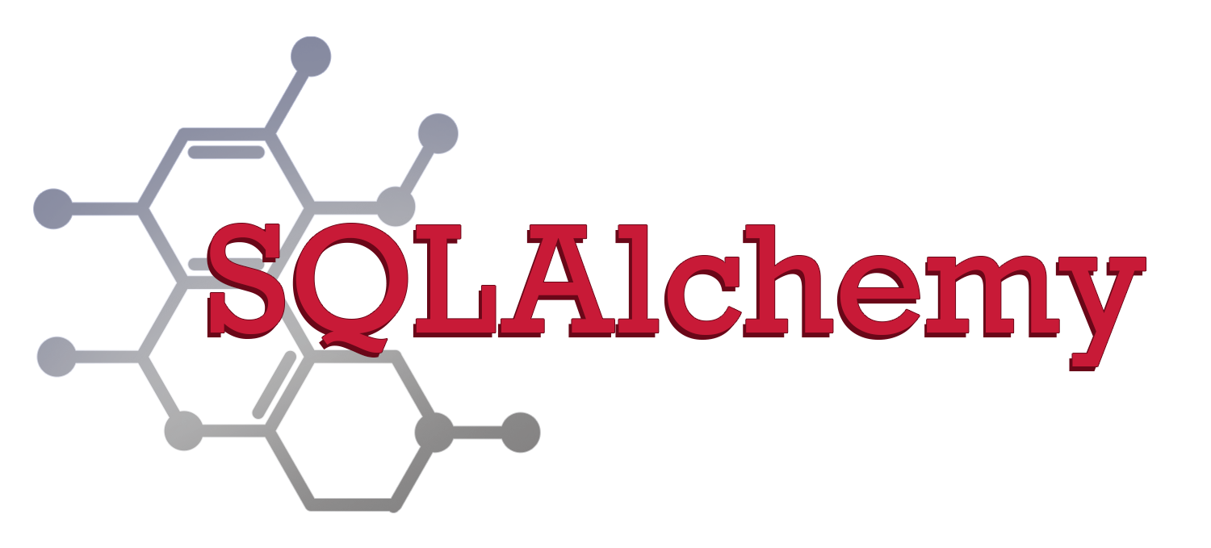
Brief Introduction: Python Features
Wide variety of external libraries

Slide 16
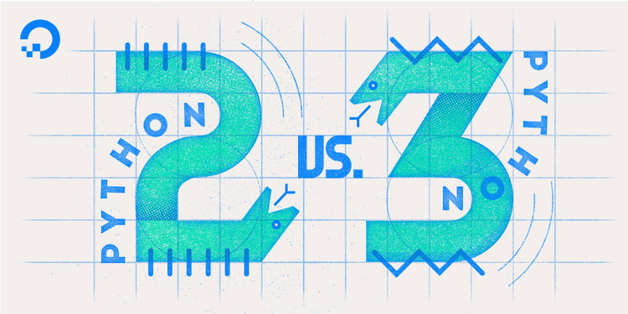
Brief Introduction: Python types
There is more than one Python
Python 2 is an earlier version of the original Python. Its development has been intentionally stalled and has reached the end of its life on January 1, 2020.
Python 3 is the newest (to be precise, the current) version of the language. It is going through its own evolutionary path, creating its own standards and habits.
If you are going to start a new Python project, you should use Python 3, this is the version of Python that will be used during this course.

Slide 17
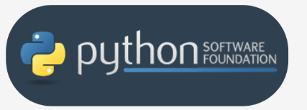
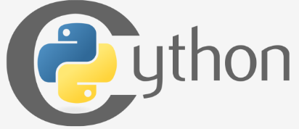
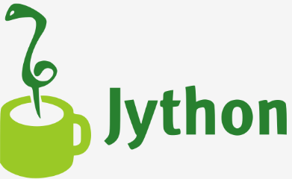
Brief Introduction: Python types
There is more than one Python
Jython: It is Python but instead of being written in C it is written in Java so it integrates with the Java architecture more easily.
Python alias CPython: Maintained by the Python Software Foundation and written in C
Cython: It aims to automatically translate Python code (not very fast) to "C" code (talkative, but agile).

Slide 18
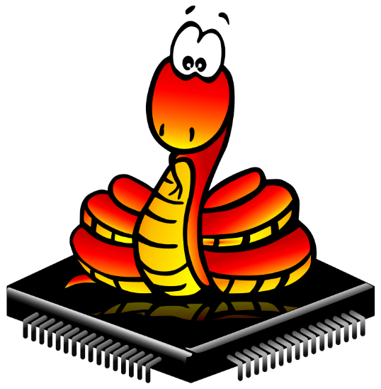

Brief Introduction: Python types
There is more than one Python
IronPython: It is an open-source implementation of Python tightly integrated with the .NET framework, being able to use both .NET and Python libraries.
MicroPython: A Python implementation optimized for microcontrollers can be run on the MicroPython pyboard.

Slide 19
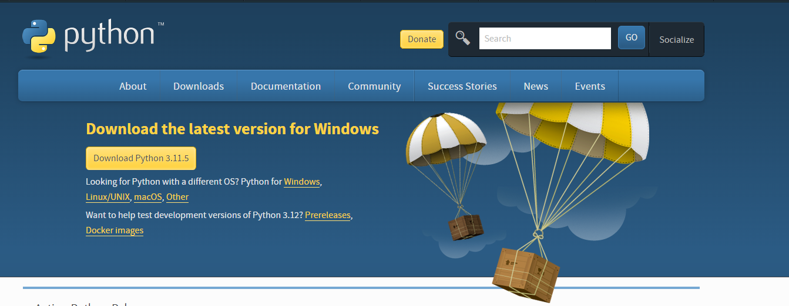
Brief Introduction: Instalation
https://www.python.org/downloads/

Slide 20
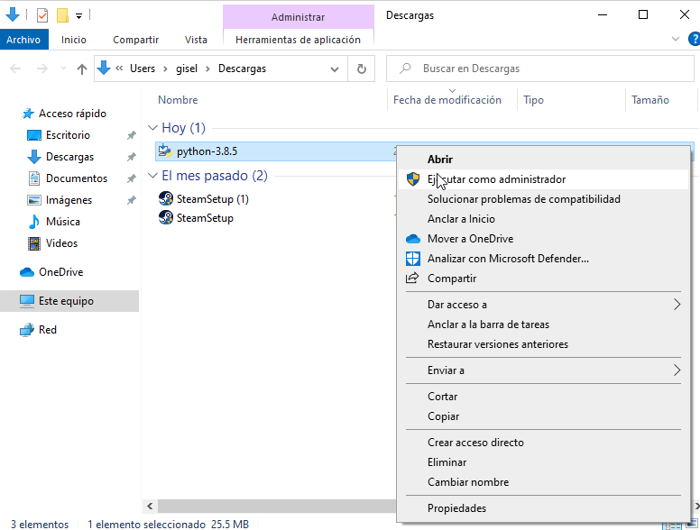
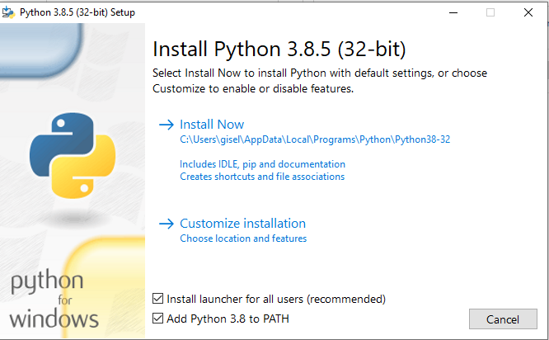
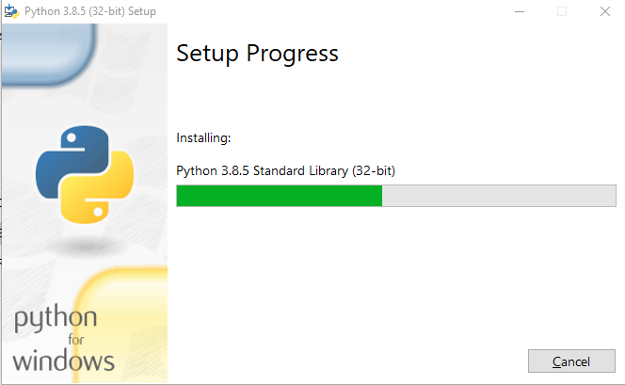
Brief Introduction: Installation

Slide 21
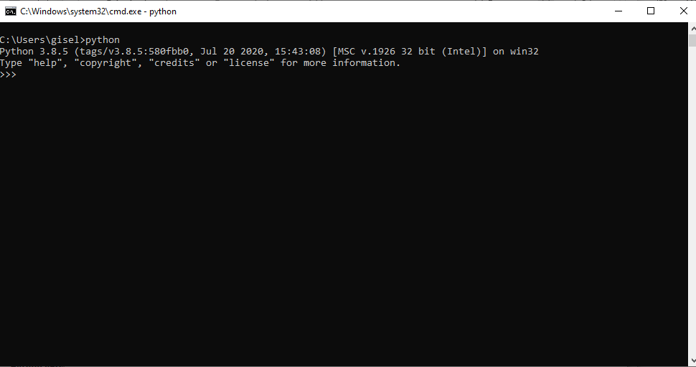
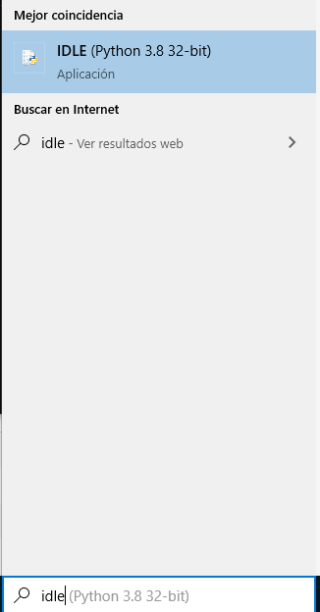
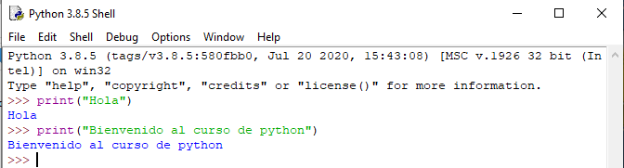
Brief Introduction: Instalation

